Slide 1

FIT TRACK PRO-Personal Health and Fitness Tracker
Atyul V Bhaskar – 1RVU23CSE090
Amogh Madhu Kashyap – 1RVU23CSE045
Abhay Aditya N – 1RVU23CSE012
Aneesh Adithya SR – 1RVU23CSE054
Vaibhav M Chittakki- 1RVUA24CSE7019
RV University, Bangalore India

Slide 2
Introduction
In today's digital age, maintaining personal health has become both a challenge and a priority. While various applications are available to monitor specific health aspects such as sleep, diet, and physical activity, they often operate in isolation. This project aims to address this gap by developing a centralized health tracking web application using the Agile Scrum methodology. The application combines modern frontend and backend technologies to provide a seamless user experience. By organizing the development into structured sprints, our team ensured steady progress, regular testing, and incremental delivery of features. The outcome is a robust, full-stack platform that integrates login authentication, sleep and workout logging, and a calorie-based diet tracker with a functioning LLM.

Slide 3
Problem Statement
Most users rely on separate apps to track health, resulting in fragmented data.
Lack of centralized systems hinders complete visibility into personal wellness.
Need for:
A unified, full-stack platform that connects various health metrics
A responsive and engaging UI that adapts to all devices
A secure backend system for storing and managing user data

Slide 4
METHODOLOGY
Our project adopted the Scrum framework under Agile methodology to manage development in iterative cycles called sprints, each spanning one week. We began by creating a product backlog outlining features like login, sleep, diet, and workout tracking. In Sprint Planning, we broke these features into achievable tasks and assigned roles.
We held daily stand-ups to track progress and resolve issues, fostering transparency and team alignment.
Sprint 1 focused on backend setup with a secure login page integrated with MySQL.
Sprint 2 emphasized frontend design using HTML and CSS, crafting key UI pages.
In Sprint 3, we enabled sleep data logging and started testing core functionalities.
Sprint 4 introduced ReactJS for a dynamic frontend and added complete feature
integration including calorie tracking, workout logs, and full backend communication.
Sprint 5 introduced a fully integrated LLM.(Further Plan)
Each sprint ended with a review and retrospective, improving our approach over time. The project was fully tested and deployed to GitHub, as reflected in the project showcasing real-time UI interaction and complete integration.

Slide 5
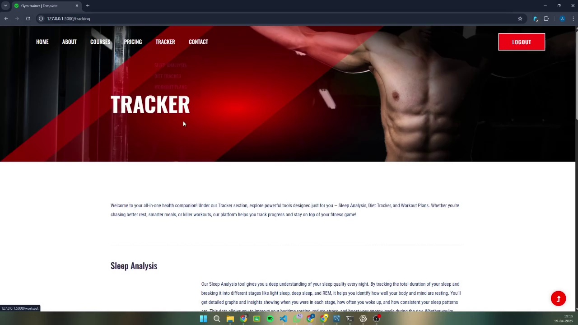
SPRINT -1
Sprint 1 focused on laying the foundation of the project—user authentication. The goal was to implement a secure login and registration system backed by a MySQL database. This sprint was crucial as it enabled user-specific data logging in later phases. The team worked on designing simple, user-friendly login forms and connected them to backend logic developed in Python. The successful integration of the frontend with SQL established the basic communication flow between the user interface and the database.
Key Deliverables:
Designed login and registration pages using HTML and CSS
Backend developed using Python and connected with MySQL
Implemented validation for:
Duplicate user entries
Incorrect credentials
Stored registered user data securely in the database
Tested form-to-database connectivity and error handling

Slide 6
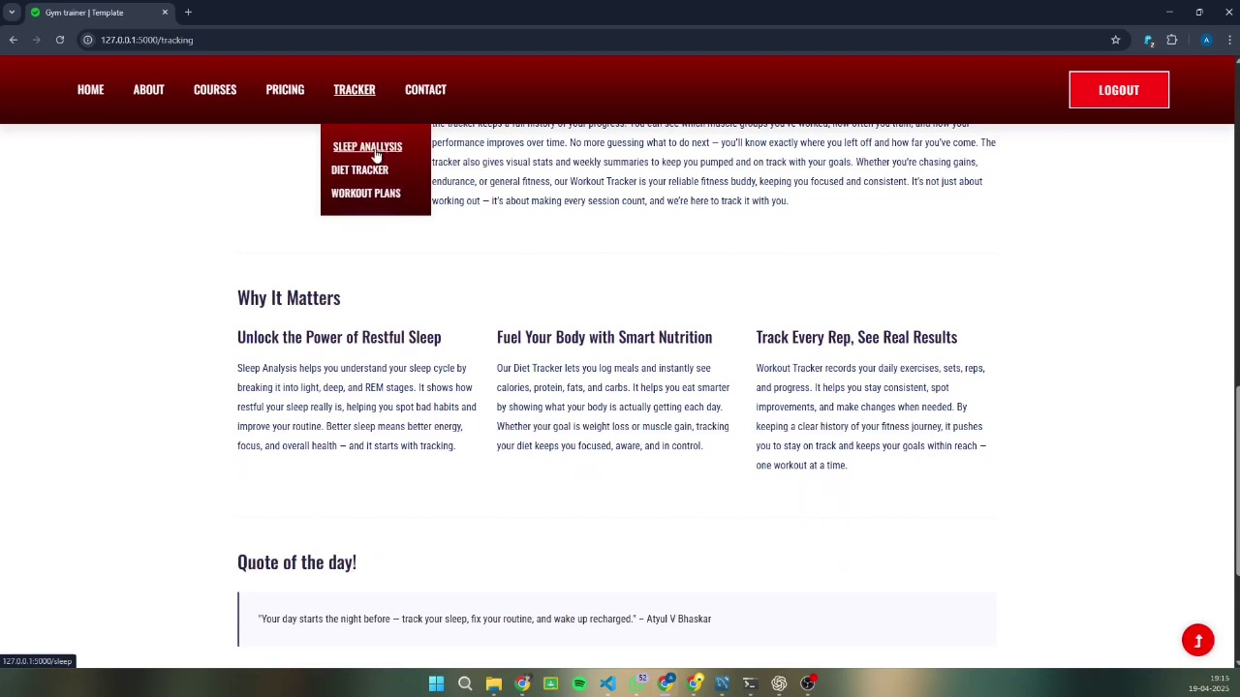
SPRINT-2
In Sprint 2, the team shifted focus to user interface development. Multiple static pages were built to structure the platform and provide a consistent navigation experience. The design followed a clean and modern aesthetic, keeping accessibility and responsiveness in mind. The pages included layouts for the home dashboard, sleep tracker, workout tracker, and diet planner. Modular CSS components were created to ensure reusability and maintainability across the application.
Key Deliverables:
Created multi-page layout:
Home Dashboard
Sleep Tracker
Workout Log
Diet Tracker
Styled each page using responsive CSS
Used grid and flex layouts for a clean, consistent look
Established consistent headers, footers, and navigational menus
Conducted initial UI testing on desktop and mobile browsers

Slide 7
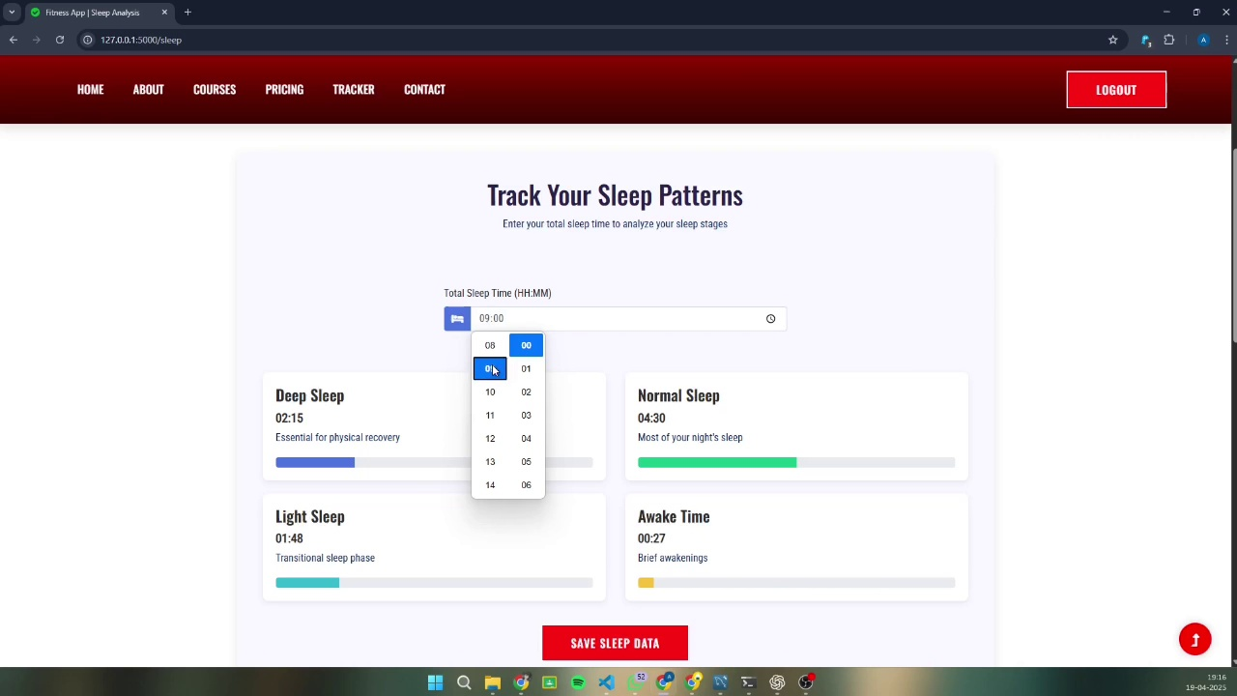
SPRINT-3
Sprint 3 marked the beginning of dynamic feature integration. The sleep tracker functionality was implemented, allowing users to input their sleep hours and log data over time. The backend logic for storing, retrieving, and displaying this data was developed using Python and MySQL. The team also prioritized testing during this sprint, ensuring that both the UI and backend worked seamlessly together. Bugs and inconsistencies were identified early, leading to better code refinement.
Key Deliverables:
Developed a form to enter sleep duration and quality
Backend support for:
Adding, viewing, and deleting sleep records
Database schema updated for user-specific entries
Testing tasks:
Py testing on input fields
Integration testing between frontend and backend
Data validation and error handling checks
Gathered initial user feedback for improvements

Slide 8
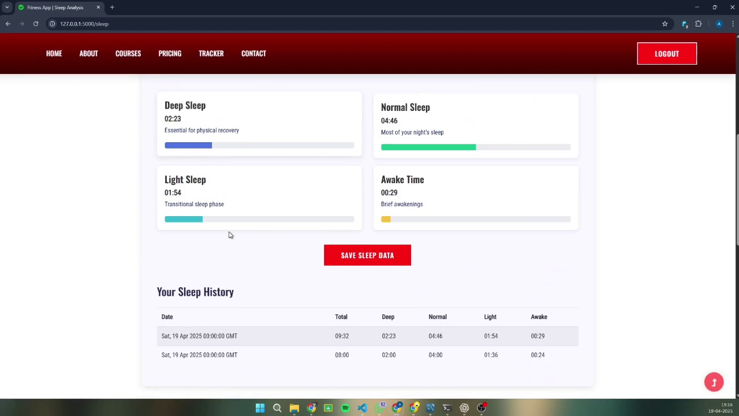
SPRINT – 4
Sprint 4 was the most intensive and rewarding phase of the project. The application was migrated to ReactJS to allow for component-based architecture and smoother state management. Advanced features like the diet tracker with calorie input, workout logger, and enhancements to the sleep tracker were introduced. These features were built as modular React components and connected to backend endpoints for real-time functionality. The team also finalized testing and deployed the project to GitHub with full documentation and integration. Setting up LLM layout.
Key Deliverables:
Migrated frontend to ReactJS for dynamic rendering
Developed and integrated the following:
Diet Tracker: Add meals and auto-calculate total calories
Workout Logger: Record exercise types, durations, and notes
Enhanced Sleep Tracker: Historical logs, graphs (optional)
Full integration of:
React + Python (Flask/Backend) communication
MySQL database with all modules
Conducted end-to-end testing of the full application

Slide 9
SPRINT-5
We have focused on creating a LLM for our project
Goal : Enhance user experience by enabling natural language interaction for health and fitness-related queries.
Overview : In this sprint, we integrated the google/gemma-2b-it large language model, which was downloaded from Hugging Face and run locally using the transformers accelerate Python libraries. This allowed us to implement a smart chat feature where users can ask fitness-related questions and receive intelligent, conversational responses. A user-friendly chat interface was developed using React, with backend support handled by Flask to connect the frontend to the local LLM. This addition significantly improves the interactivity and usefulness of our application.
Lists supported topics like: Workout routines, Nutrition advice, Exercise techniques,Recovery tips

Slide 10
Results
.
The successful completion of the project resulted in a robust, responsive, and user-friendly health tracking application developed using Agile Scrum methodology. All key features, including user authentication, sleep logging, workout tracking, and diet monitoring, were implemented and thoroughly tested. The project not only met its functional goals but also demonstrated strong full-stack integration using React, HTML/CSS, Python, and MySQL. Throughout the development process, regular testing and sprint reviews ensured code quality and timely delivery. The final version was deployed on GitHub, complete with a working frontend-backend system, and can serve as a foundation for more advanced health-related web platforms in the future.
Key Achievements:
Developed a complete full-stack application using modern web technologies.
Implemented secure login & registration with SQL-based user data persistence.
Created a Sleep Tracker with storage, retrieval, and optional visualization.
Designed a Workout Logger with input for exercises, durations, and user notes.
Built a Diet Tracker that calculates total calorie intake per day.
Migrated to ReactJS for responsive and modular frontend performance.
Added a LLM to the website for responses.
Achieved seamless integration between React frontend, Python backend, and MySQL database.
Conducted:
Unit testing for individual modules
Integration testing across components
UI testing on desktop devices

Slide 11
Future Scope & Conclusion
The Scrum methodology helped manage the project efficiently, allowing iterative progress.
Regular feedback and testing led to early detection of issues and continuous improvement.
Technologies were successfully combined to build a cross-platform, full-stack solution.
Future Enhancements:
Integrate real-time data visualization with charts and trends
Deploy on a public server or cloud platform
Add machine learning-based health recommendations and alerts
Improve LLM further

Slide 12
Thank you

